Slide 1

Sand Art
Color object and inversion

Slide 2
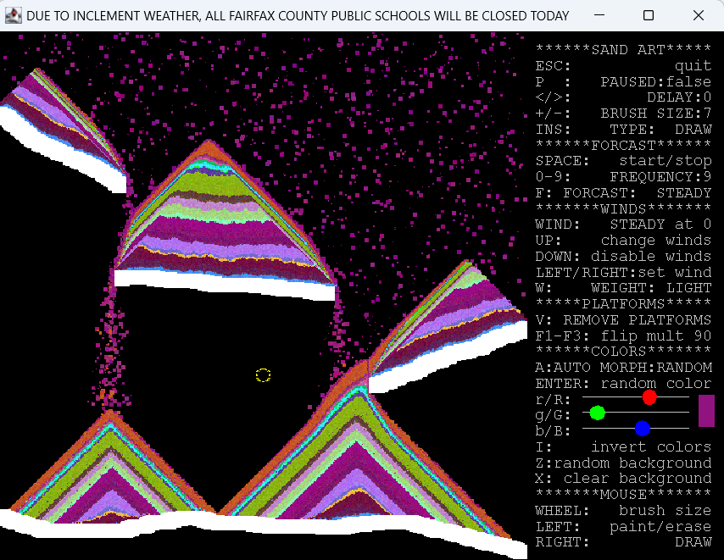
Sand Art
This program will allow you to drop colored sand from the top of the screen like falling snow.
Draw platforms to catch the sand and remove them to witness entropy.
The cursor can be toggled between 3 states with right-mouse click or the INSERT key:
Draw tool: mouse wheel or + - keys to change brush size
Remove tool: will erase platforms
Shower tool: sand will fall from the moveable shower head
The color of the sand can be directed using r, g, b sliders or randomized in different ways.
You will add the ability to invert the colors or flip the screen in multiples of 90 degrees.

Slide 3
java.awt.Color
The Java Color object can be used to give color to JPanels and BufferedImages to fill up frames.
Colors are comprised of 4 primary data-fields:
red value (0-255)
green value (0-255)
blue value (0-255)
alpha value (0-255) //transparency amount, 0==transparent

Slide 4
java.awt.Color
red, green, blue
Color fullRed = new Color(255, 0, 0);
Color fullGreen = new Color(0, 255, 0);
Color fullBlue = new Color(0, 0, 255);
Color purple = new Color(150, 0, 200);
Color cyan = new Color(0, 255, 255);
Color black = new Color(0, 0, 0);
Color white = new Color(255, 255, 255);
Color gray = new Color(127, 127, 127);
Any color can be created by mixing values of red, green and blue.
Values must be between 0 and 255. Any value out of that range will throw a run-time error.
If all three values for r, g, b are the same, you will have some shade of gray between black and white.
Colors can be used to outline or fill shapes in Graphics or for text drawn out to panels.

Slide 5
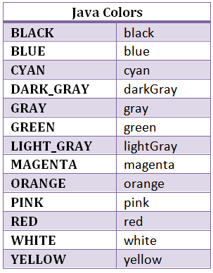
Color and the alpha channel
import java.awt.Color;
Color c1 = new Color(red, green, blue);
Color c2 = new Color(red, green, blue, alpha);
Color c3 = Color.ORANGE;
c3 = c3.darker();
Color c4 = c1.brighter().brighter();
int r = c3.getRed();
Integer values between 0 and 255
Transparency value:
0 (invisible) to 255 (solid)
Or use a pre-defined color code
https://docs.oracle.com/javase/7/docs/api/java/awt/Color.html
Find interesting methods here.

Slide 6
java.awt.Color
The inverse of any color can be found with some simple arithmetic. Look for the pattern:
Color Inverse
red (255, 0, 0) cyan (0, 255, 255)
green (0, 255, 0) purple (255, 0, 255)
white (255,255,255) black (0, 0, 0)
gray (127, 127, 127) gray (127, 127, 127)
rand1 (6, 75, 209) rand 2 (249, 180, 46)

Slide 7
Inverting the Colors in Sand Art
//pre : c!= null. //post: returns the inverted color from the one sent as c. public static Color invert(Color c) { return c; //temporary return statement to keep things compiling } //pre: m!= null. //post: for each non-null element of m, changes it to its inverted color. // skips any color with the value skip1 and skip2, leaving them unchanged. public static void invertColors(Color[][]m, Color skip1, Color skip2) {
}
The 2-D array m is comprised of Color objects for each pixel of colored sand.
Some elements in the array m will be null which should be skipped.
skip1 is the color of the platforms which should not be inverted.
skip2 is the color of the background which should also be left alone.
The invert method will not change the color sent, rather it will return a new instance of a color.

Slide 8
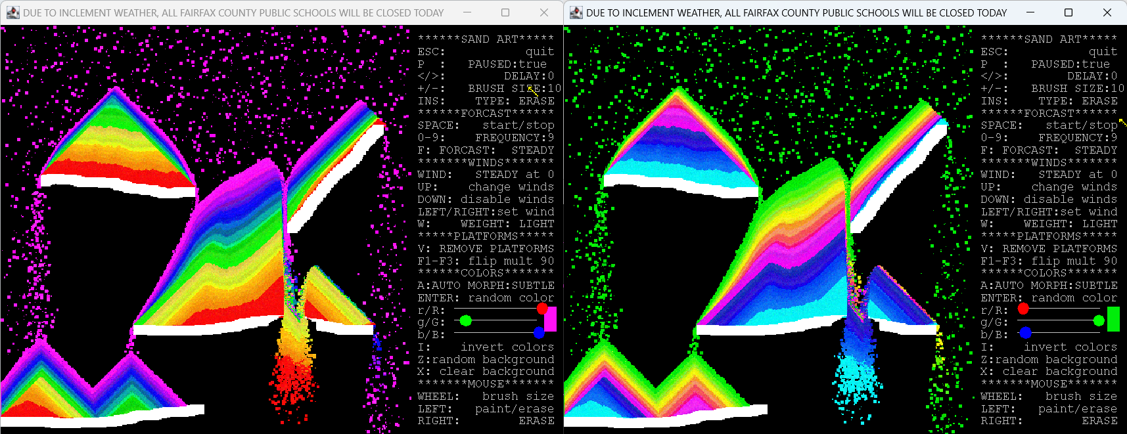
Inverting the Colors in Sand Art

